Slide 1
Big Mountain Resort
How can the cost of new lift be offset by optimizing ticket prices and facilities?

Slide 2
Problem Identification
Big Mountain has increased operational costs by 1.5 million this season by installing a new lift.
Can these costs be offset by identifying what factors contribute to higher ticket prices, and predicting Big Mountains ability to increase ticket prices?
What does the country’s ski resort data show are the most indicative variables of higher ticket prices?

Slide 3
Possible Problems
Does Big Mountain have competitive amenities/facilities?
Will raising ticket prices be enough to offset higher operational costs?

Slide 4
Key Results
Analysis of the data shows that Big Mountain lies above the majority of the market share of ski resorts for all variables that contribute to higher ticket prices.
A predictive model, with the scenario that each visitor would purchase 5 tickets, the resort could withstand a price increase of $8.61 which would in turn lead to a yearly revenue increase of $15,065,471.

Slide 5
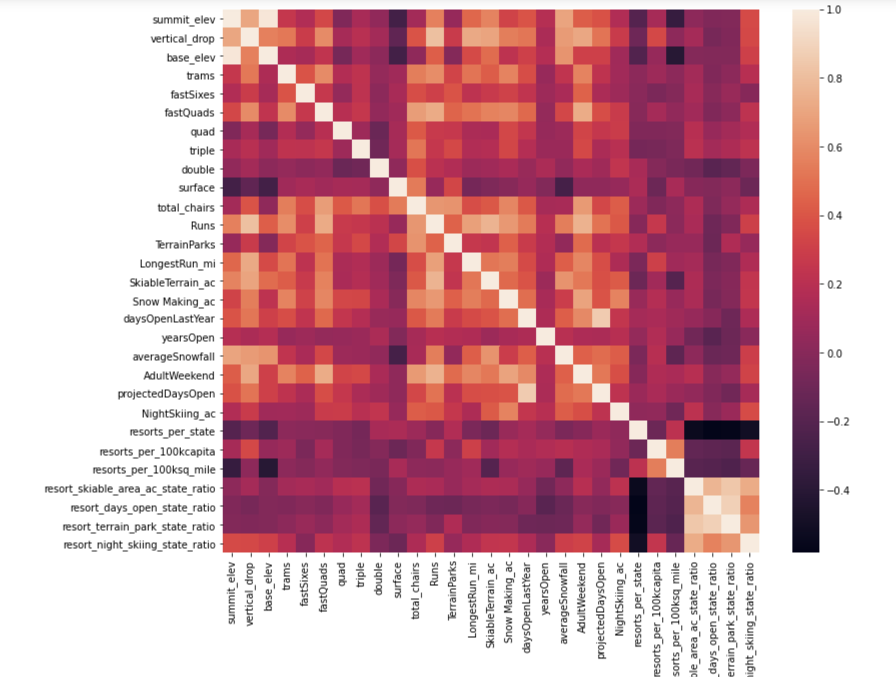
Modeling & Analysis
To find these key indicators, we first cleaned the data and then created a correlation heat map in order to identify which variables were highly correlated with ticket price. As seen below, we can tell that the variables with the highest correlation to ticket price are Vertical drop, Fast Quads, Total Chairs, Total Runs, Snow Making acreage, and Days open.

Slide 6
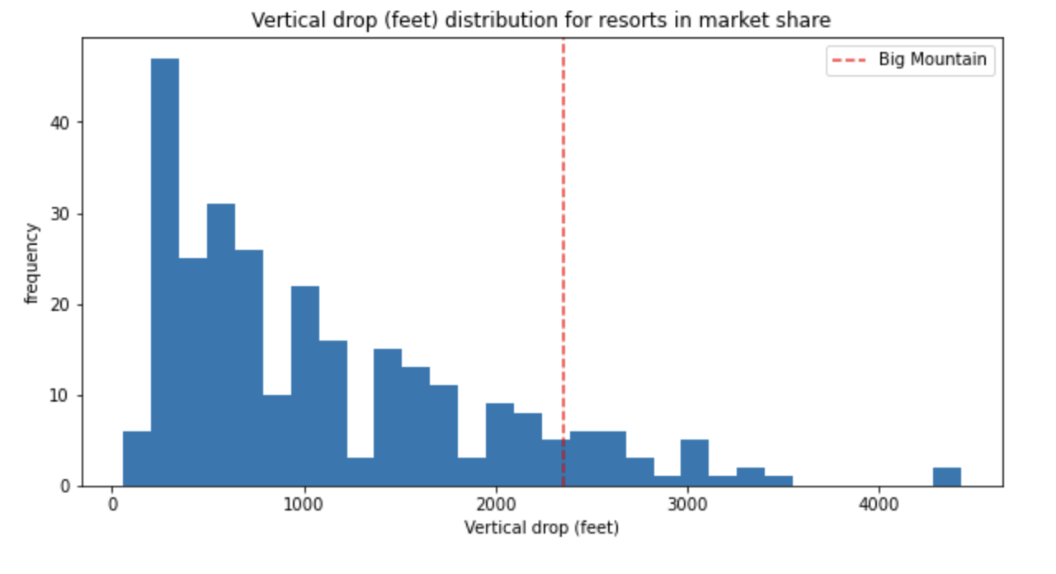
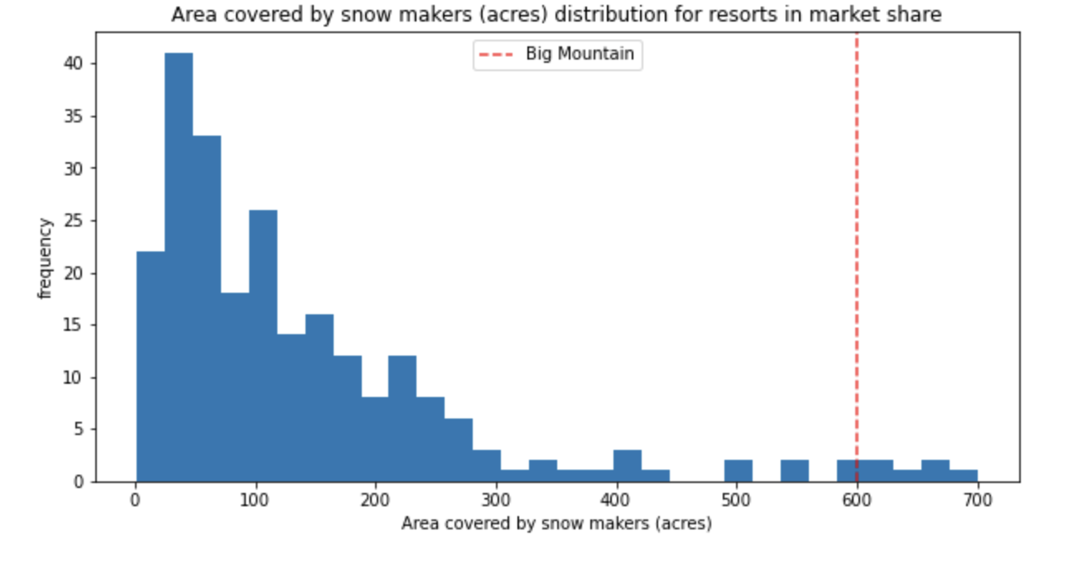
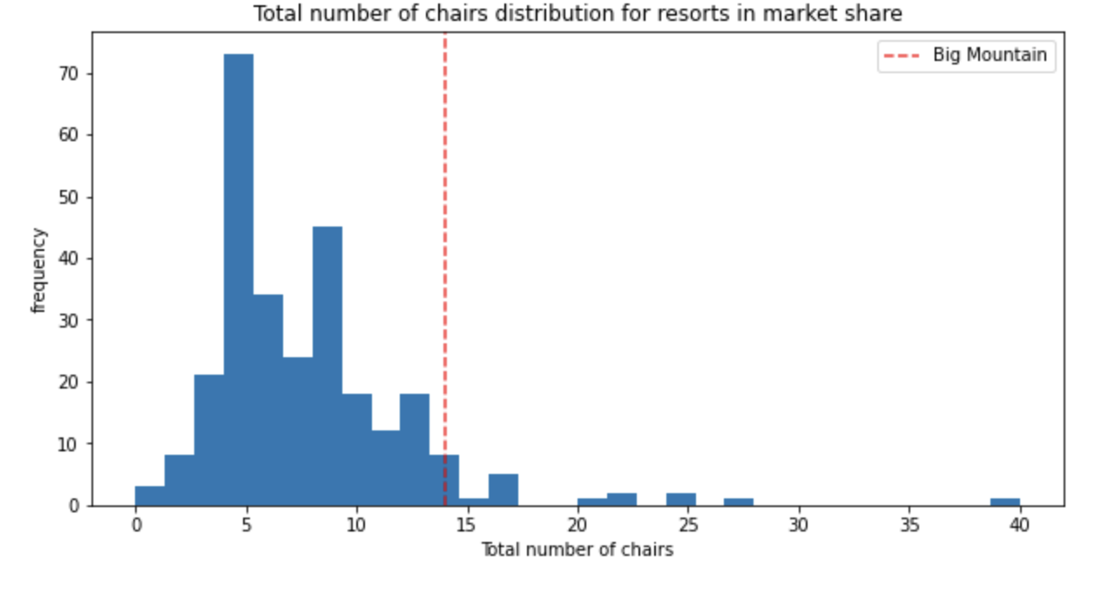
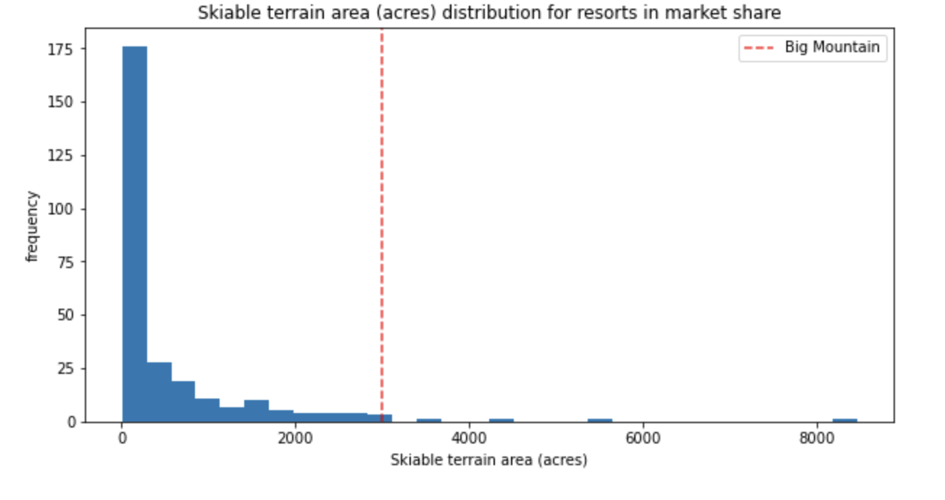
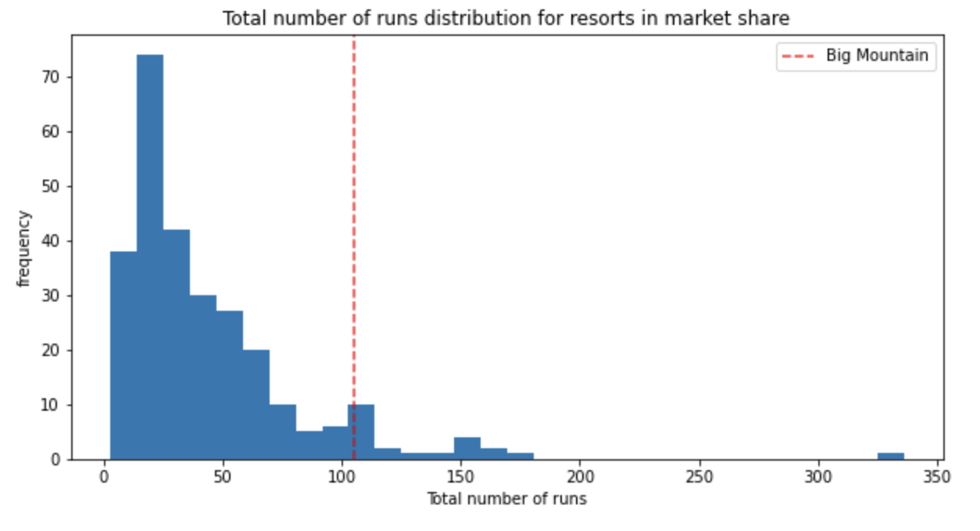
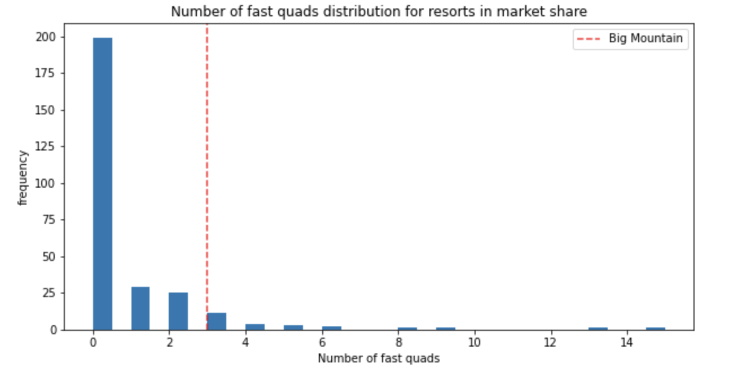
Modeling & Analysis
We wanted to find the key variables that are correlated with high ticket prices to see how Big Mountain Compares. Below are some comparisons of this data, here we can see that Big Mountain, as noted as the red dashed line, is above the majority for each of these key indicator variables for price.

Slide 7
Modeling & Analysis
Finally, based on the key indicator findings as well as where Big Mountain falls in relation to other resorts considering these variables, we created a function to predict the available cost increase based on resorts with similar features. This model was able to identify the ticket price could increase as much as $8.61.
This model also lends itself to future planning as it can predict the ticket price change associated with changes in key variables.

Slide 8
Summary
Considering all data and using strategic comaparisons in regards to key variables, it has been determined that Big Mountain is able to increase ticket prices by approximately $8.61 which will lead to an increase of revenue of $15,065,471. This will offset the operating costs of the newly installed lift and encourage resort growth.

